Slide 1
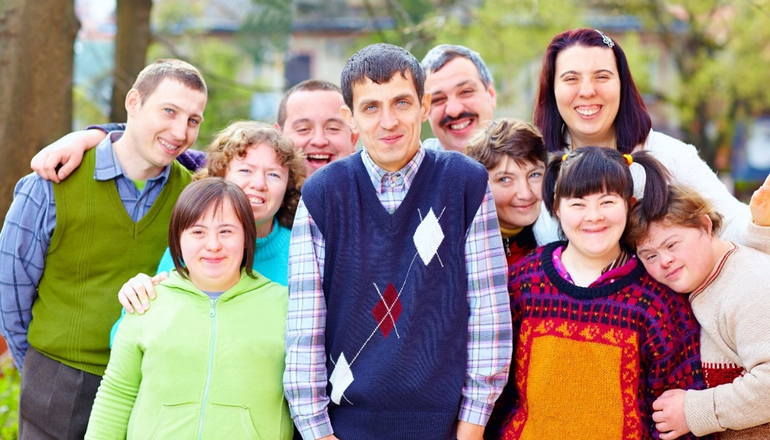
Implement Strategies for Community Participation and Inclusion
CHCDIS012 - Support community participation and social inclusion (Release 1)

Slide 2



We will now focus on implementing strategies according to the individualised plan.
You will use your knowledge in identifying support services to meet your client’s needs.
You need to learn these things to ensure that your clients get the support they need to thrive in their social and work networks.
Implement Strategies for Community Participation and Inclusion

Slide 3
The individualised plan should detail:
What services will be provided to address the interests, needs, abilities and preferences of persons with disability
How each service will meet the interests, needs abilities and preferences persons with disability
Who will provide the services and assist the persons with disability with their community participation programs and activities.
Implement Strategies for Community Participation and Inclusion

Slide 4
Each detail in the individualised plan must be agreed upon by the following stakeholders:
The person with disability
The family of the person with disability
The carer of the person with disability
Others identified by the person with disability (e.g. external stakeholders such as Allied Health, guardians (public or financial), or person nominated)
Implement Strategies for Community Participation and Inclusion

Slide 5
As a disability support worker, part of your job is to implement strategies based on your clients’ individualised plans.
Your clients may already have strategies in place to support their community participation and inclusion.
As such, you must execute these strategies in collaboration with your clients and other stakeholders.
Failure to do so can lead to your clients having unmet needs, which can lower the quality of their lives and increase their dependence on others.
Implement Strategies for Community Participation and Inclusion

Slide 6
In this presentation, you will learn how to:
Assist the person with disability to identify and access community options based on their individualised plan
Support the person with disability in establishing connections through shared interests
Support the work participation of the person with disability and assist employer for inclusion
Support the use of assistive technologies of the person with disability
Implement Strategies for Community Participation and Inclusion

Slide 7
In this presentation, you will learn how to:
Seek feedback from the person with disability and others on meeting the person’s needs and preferences
Ensure strategies are regularly reviewed with the person with disability and supervisor
Monitor the level of engagement in community and social networks of the person with disability
Implement Strategies for Community Participation and Inclusion

Slide 8

2.1
Assist the Person With Disability to Identify and Access Community Options Based on Their Individualised Plan

Slide 9
As a disability support worker, you must truly put the person with disability at the centre of all decisions.
So, the person with disability is both the recipient and source for all strategies implemented within the individualised plan.
There is a tendency that support workers do not to consider the opinions of persons with disability. However, this should not be the case.
Implement Strategies for Community Participation and Inclusion

Slide 10
Persons with disability are more capable of determining what community options they would like to take due for the following reasons:
They know and understand their own experiences better than anyone.
They may have feelings or emotions that others may not understand.
They may have desires or preferences that might not make sense to others.
They can speak and thus provide more detailed or specific information on what they need help with.
Implement Strategies for Community Participation and Inclusion

Slide 11
Involving your clients in their individualised plan provides the following benefits:
It frames clients as capable of making operational decisions rather than seeking help
It increases clients' understanding of their strengths and limitations
It encourages clients to take part in activities, routines and programs they choose
Implement Strategies for Community Participation and Inclusion

Slide 12
To work with your clients to identify and access community options, you must do the following:
Let clients choose how their needs should be addressed and what options will meet their needs and preferences
Inform clients of risky programs and activities
Encourage clients to be vocal and bring up questions or concerns they might have
Provide necessary assistance to clients according to their disability
Implement Strategies for Community Participation and Inclusion

Slide 13
2.1.1 Identify Community Options That Will Meet Needs and Preferences Identified in Their Individualised Plan
When working with clients to identify community options that will meet needs and preferences, consider the following strategies:
Consider the relationship of the client with those involved in the individualised plan.
Encourage communication between you, the client and other stakeholders.
Acknowledge that the client’s family and carer and other stakeholders play a vital role in supporting them.
Acknowledge the different views of the client and other stakeholders.
Implement Strategies for Community Participation and Inclusion

Slide 14
2.1.2 Access Community Options That Will Meet Needs and Preferences Identified in Their Individualised Plan
There are services your organisation may provide clients to meet their community participation needs.
However, there are times when the support the client needs is beyond your capabilities.
When this happens, consider seeking services from other community participation agencies to meet these needs. You may do so by making referrals.
Implement Strategies for Community Participation and Inclusion

Slide 15

A referral is a process of connecting to the community participation services outside of your area of expertise.
This means asking other agencies to handle and meet the clients’ needs and preferences based on their individualised plans.
Implement Strategies for Community Participation and Inclusion

Slide 16
Referrals can be categorised in the following ways:
Warm referral | Cold referral
A support worker discusses how other agencies can provide for the client's needs to gain their consent. | A support worker provides only the contact details and basic information of other agencies. The client then can contact them by themselves.
Implement Strategies for Community Participation and Inclusion

Slide 17
You can refer to the following procedures when referring clients to other agencies to meet their needs and preferences:
Identify what support the client needs.
Develop a list of available agencies.
Present the list of available agencies to the client.
Implement Strategies for Community Participation and Inclusion

Slide 18

You can refer to the following procedures when referring clients to other agencies to meet their needs and preferences:
Once the client agrees to an agency, contact the agency on their behalf with a warm referral.
Define the role of the agency.
Record and report the referrals.
Implement Strategies for Community Participation and Inclusion

Slide 19
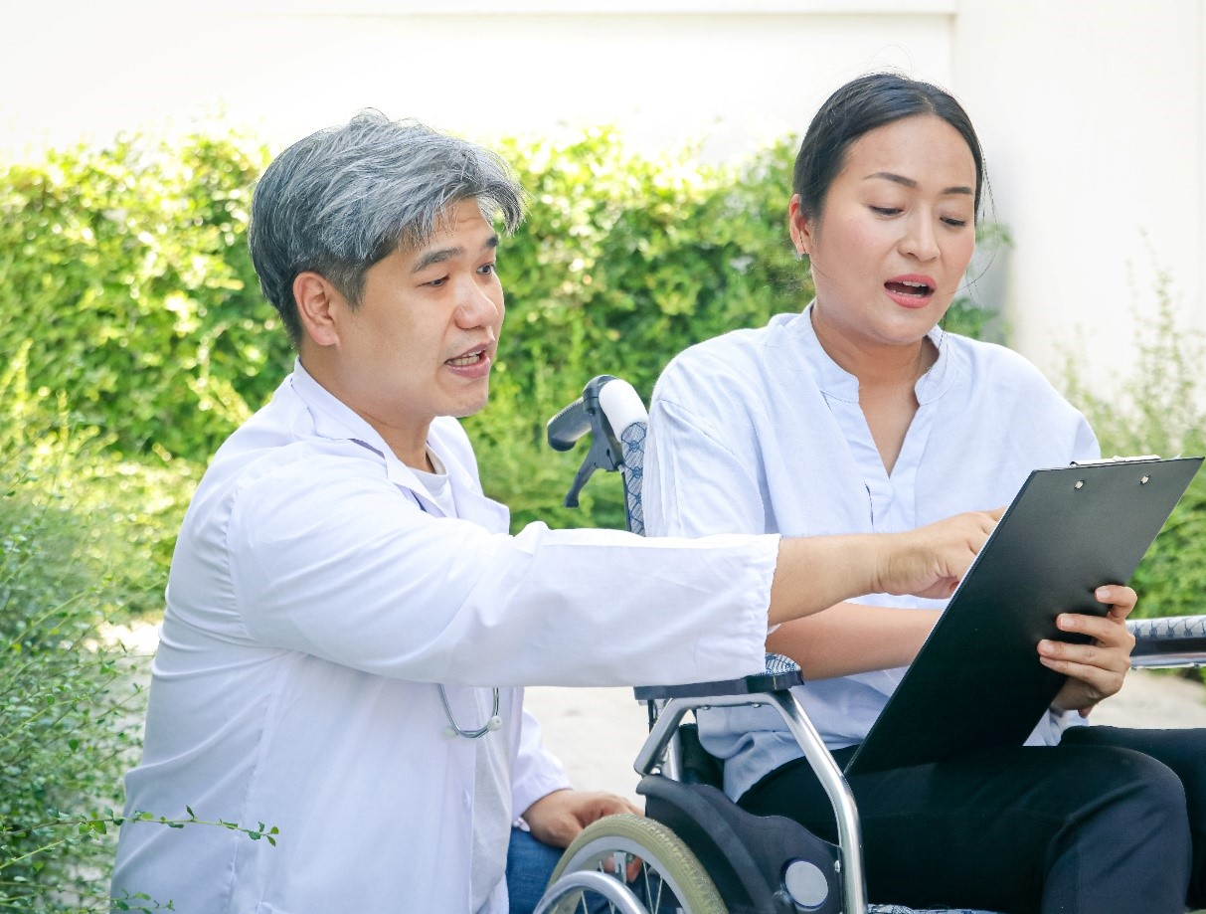
2.2
Support the Person With Disability in Establishing Connections Through Shared Interests

Slide 20
2.2 Support the Person With Disability to Access Opportunities to Establish Connections Through Shared Interests
Shared interests mean that a person’s interests are similar to others.
They can establish connections through shared interests by engaging with others in various social networks.
In these social networks, the person can join groups that share their interests.
Implement Strategies for Community Participation and Inclusion

Slide 21
A person’s interests may fall under the following groups:
Sporting groups
Cultural groups
Specific-interest groups
Implement Strategies for Community Participation and Inclusion

Slide 22
As a support worker, you should support your clients as they access community inclusion opportunities.
Failure to support and guide clients in accessing opportunities may result in:
Difficulty for the client to socialise with others due to their impairments
Too many options that the client can no longer decide what is appropriate for them
Missed opportunities for the client to socialise with others
The client not being able to connect with others in the social networks
Implement Strategies for Community Participation and Inclusion

Slide 23
To support clients to access opportunities to establish connections through shared interests, consider the strategies below.
Consult with the client to determine current interests.
Find appropriate social networks for the client.
Conduct further studies on the social networks.
Seek the client’s feedback.
Implement Strategies for Community Participation and Inclusion

Slide 24
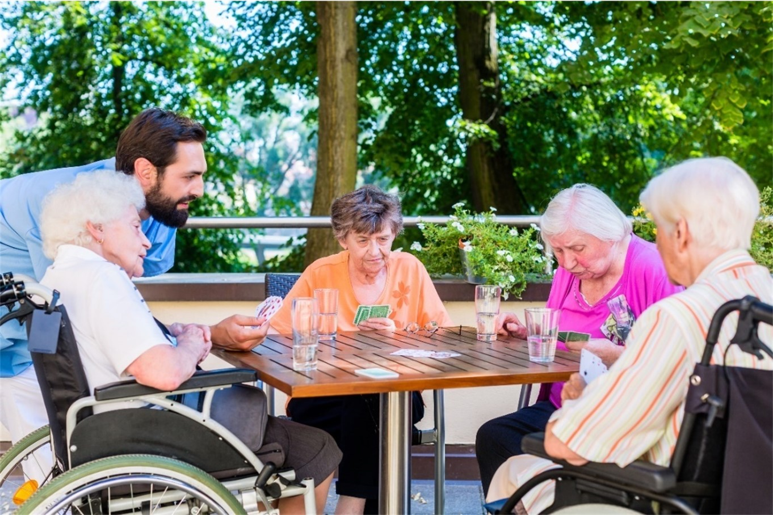
2.3
Support the Work Participation of the Person With Disability and Assist Employer for Inclusion

Slide 25
The workplace is one of the most common and important settings for a person to build a community or social network.
Since most jobs require people to stay at work 37.5 hours per week, colleagues spend a lot of time together as they bond over their successes and struggles in their job.
This encourages people to build connections with one another at the workplace.
You must support your clients to access opportunities for participation at work.
This support also includes assisting their employers in easing the clients’ participation and inclusion.
Implement Strategies for Community Participation and Inclusion

Slide 26
2.3.1 Assisting Employers to Facilitate the Inclusion and Engagement of the Person With Disability in the Workplace
Your role involves assisting your clients’ employers in facilitating their participation and inclusion in the workplace.
Doing so will aid in identifying opportunities for the clients’ participation at work.
Implement Strategies for Community Participation and Inclusion

Slide 27
Below are some ways for you to help employers in facilitating participation and inclusion:
Provide the employer with information on national and international policies regarding persons with disability, especially in connection to employment.
Give feedback on the company policies and procedures on how they check up on employee conditions.
Advise the employer and management to create events that encourage socialising with co-workers.
Implement Strategies for Community Participation and Inclusion

Slide 28
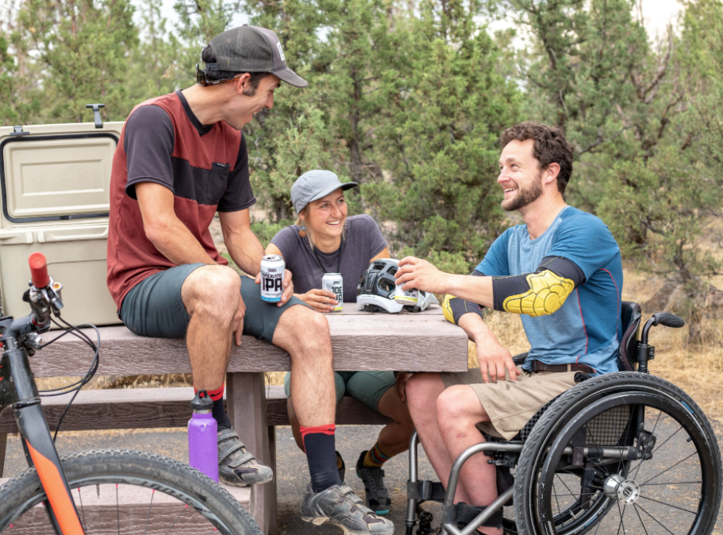
Below are some ways for you to help employers in facilitating participation and inclusion:
Suggest revising company policies as needed to accommodate the client’s needs.
Implement Strategies for Community Participation and Inclusion

Slide 29
2.3.2 Supporting the Person With Disability to Access Opportunities for Work Participation
Once participation opportunities are present in the workplace, you also have a role in assisting the person with disability in accessing them.
Assisting the employer in adjusting company policies for persons with disability is in itself already a huge part of that.
However, the person with disability may still need further assistance on the implementation of the specific activities themselves.
Implement Strategies for Community Participation and Inclusion

Slide 30
You can support clients to access opportunities with the following strategies:
Keep open communication and close contact.
Assist the client in accessing their needs and resolving barriers as often as needed.
Apply the steps and strategies in the individualised plan.
Implement Strategies for Community Participation and Inclusion

Slide 31

2.4
Support the Use of Assistive Technologies of the Person With Disability

Slide 32

Assistive technology refers to the devices and equipment designed to support persons with disability.
These technologies help people live their independent lives.
Implement Strategies for Community Participation and Inclusion

Slide 33
Using assistive technology can do the following:
Positively impact the health and wellbeing of the person with disability
Promote the independence of the person with disability
Maintain the independence of the person with disability
Enable the person with disability to be included in various activities available for all people
Allows the person with disability to participate in their community fully
Ease the process for making choices and decisions for the person with disability
Implement Strategies for Community Participation and Inclusion

Slide 34
2.4.1 Scope and Breadth of Assistive Technology
As a support worker, you must understand the scope and breadth of assistive technologies to identify what devices or equipment your clients need.
Once identified, you will support them in using said technology to meet their individual needs.
Scope refers to the activities where a person can use assistive technology.
On the other hand, breadth refers to the range of devices and equipment used explicitly for an activity.
Implement Strategies for Community Participation and Inclusion

Slide 35
Communication
One of the common individual needs of a person is the need to communicate and interact with others.
Aside from nonverbal communication techniques, a person may use assistive devices to communicate.
Implement Strategies for Community Participation and Inclusion

Slide 36
The following tables list the breadth of assistive technology used for communication:
Impairment | Breadth of assistive technology
Hearing | FM systems Closed-captioning software Hearing aids
Speech | Communicators Eye gaze Text-to-speech software (TTS)
Implement Strategies for Community Participation and Inclusion

Slide 37
The following tables list the breadth of assistive technology used for communication:
Impairment | Breadth of assistive technology
Speech | Notepads
Vision | Alternative print materials Pocket magnifiers Audiobooks Reading gadgets Refreshable braille displays
Implement Strategies for Community Participation and Inclusion

Slide 38
The following tables list the breadth of assistive technology used for communication:
Impairment | Breadth of assistive technology
Vision | Text-to-speech (TTS) Visual support software
Implement Strategies for Community Participation and Inclusion

Slide 39
The following tables list the breadth of assistive technology used for communication:
Impairment | Breadth of assistive technology
Cognition and Memory Loss | Sensory regulators Noise-cancelling headphones Memory Aids Word prediction software Autocomplete
Implement Strategies for Community Participation and Inclusion

Slide 40
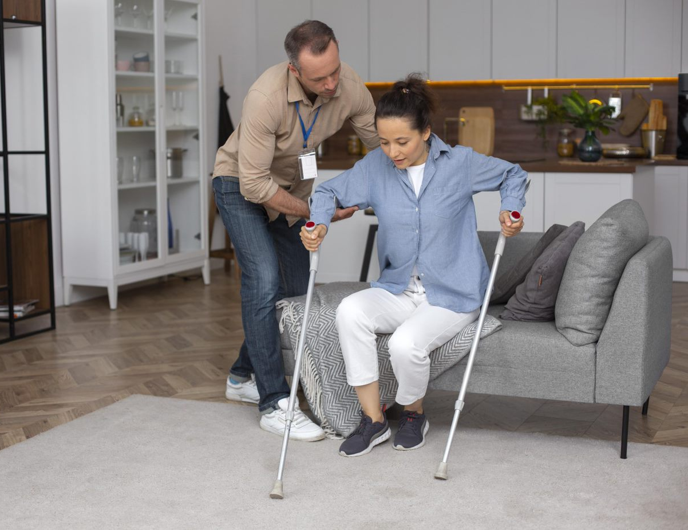
Daily Living Activities
Daily living activities are the self-care activities people do every day to keep themselves safe, healthy and feeling good.
These activities are usually done in the home of the person with disability.
They are also done independently by the person with disability.
Implement Strategies for Community Participation and Inclusion

Slide 41
The following tables list the breadth of assistive technology used for the kinds of activities of daily living (ADL) or instrumental activities of daily living (IADL):
ADL/IADL | Breadth of assistive technology
Continence | Bedpans Bedside commodes Bed and chair pads Toilet seat raisers Urine drainage bags
Implement Strategies for Community Participation and Inclusion

Slide 42
The following tables list the breadth of assistive technology used for the kinds of activities of daily living (ADL) or instrumental activities of daily living (IADL):
ADL/IADL | Breadth of assistive technology
Self-Care and Hygiene | Grab bars Shower chairs or benches Anti-slip mats
Implement Strategies for Community Participation and Inclusion

Slide 43
The following tables list the breadth of assistive technology used for the kinds of activities of daily living (ADL) or instrumental activities of daily living (IADL):
ADL/IADL | Breadth of assistive technology
Self-Care and Hygiene | Button hooks Toothbrush grips Nightlights
Implement Strategies for Community Participation and Inclusion

Slide 44
The following tables list the breadth of assistive technology used for the kinds of activities of daily living (ADL) or instrumental activities of daily living (IADL):
ADL/IADL | Breadth of assistive technology
Mobility | Walking sticks, walkers, crutches and canes Wheelchairs Prosthetic arms/legs Walking stick Reachers
Implement Strategies for Community Participation and Inclusion

Slide 45
The following tables list the breadth of assistive technology used for the kinds of activities of daily living (ADL) or instrumental activities of daily living (IADL):
ADL/IADL | Breadth of assistive technology
Transferring | Slide sheets Transfer belts Transfer boards Slings Stretchers
Implement Strategies for Community Participation and Inclusion

Slide 46
The following tables list the breadth of assistive technology used for the kinds of activities of daily living (ADL) or instrumental activities of daily living (IADL):
ADL/IADL | Breadth of assistive technology
Transferring | Hoists Ramps
Implement Strategies for Community Participation and Inclusion

Slide 47
The following tables list the breadth of assistive technology used for the kinds of activities of daily living (ADL) or instrumental activities of daily living (IADL):
ADL/IADL | Breadth of assistive technology
Eating and Drinking | Adaptive dinnerware Assistive utensils Utensil holders Weighted utensils
Implement Strategies for Community Participation and Inclusion

Slide 48
The following tables list the breadth of assistive technology used for the kinds of activities of daily living (ADL) or instrumental activities of daily living (IADL):
ADL/IADL | Breadth of assistive technology
Eating and Drinking | Non-skid plates Feeding devices Assistive cups and mugs
Implement Strategies for Community Participation and Inclusion

Slide 49
The following tables list the breadth of assistive technology used for the kinds of activities of daily living (ADL) or instrumental activities of daily living (IADL):
ADL/IADL | Breadth of assistive technology
Eating and Drinking | Straws No-spill lids Jar openers
Implement Strategies for Community Participation and Inclusion

Slide 50
The following tables list the breadth of assistive technology used for the kinds of activities of daily living (ADL) or instrumental activities of daily living (IADL):
ADL/IADL | Breadth of assistive technology
Pressure Area Management | Protectors Cushions Offloading footwear Sleep positioners Electronic bed frames
Implement Strategies for Community Participation and Inclusion

Slide 51
The following tables list the breadth of assistive technology used for the kinds of activities of daily living (ADL) or instrumental activities of daily living (IADL):
ADL/IADL | Breadth of assistive technology
Carer Support | Fall detectors Passive infrared detectors Panic buttons Personal alarms Smart plugs
Implement Strategies for Community Participation and Inclusion

Slide 52
The following tables list the breadth of assistive technology used for the kinds of activities of daily living (ADL) or instrumental activities of daily living (IADL):
ADL/IADL | Breadth of assistive technology
Recreation and Leisure | Adapted equipment Magnetic board game pieces All-terrain wheelchairs Self-driving cars
Implement Strategies for Community Participation and Inclusion

Slide 53
The following tables list the breadth of assistive technology used for the kinds of activities of daily living (ADL) or instrumental activities of daily living (IADL):
ADL/IADL | Breadth of assistive technology
Education and Employment | Ergonomic furniture Pen/pencil grips
Implement Strategies for Community Participation and Inclusion

Slide 54
The following tables list the breadth of assistive technology used for the kinds of activities of daily living (ADL) or instrumental activities of daily living (IADL):
ADL/IADL | Breadth of assistive technology
Education and Employment | Alternative print materials Audio recordings Speech-to-text software Physical modifications to the environment Elevators
Implement Strategies for Community Participation and Inclusion

Slide 55

2.4.2 Support the Use of Assistive Technology of the Person With Disability
As a support worker, you must aid your clients when they are using assistive technology.
Implement Strategies for Community Participation and Inclusion

Slide 56
In aiding your clients’ use to meet their individual needs, you need to take into consideration the following:
Make sure that assistive devices and equipment are available.
Make sure that assistive devices and equipment align with the individual needs of your clients.
Consider the budget of your clients.
Consider your clients’ environments.
Implement Strategies for Community Participation and Inclusion

Slide 57
In aiding your clients’ use to meet their individual needs, you need to take into consideration the following:
Determine if your clients need custom-made equipment.
Ensure that your clients understand how to use assistive technology.
Make sure that assistive devices and equipment are well-maintained.
Implement Strategies for Community Participation and Inclusion

Slide 58

2.5
Seek Feedback From the Person With Disability and Others on Meeting the Person’s Needs and Preferences

Slide 59
With your findings, you can adjust these strategies for community participation and inclusion.
One of your duties as a support worker is to ensure that support provided to clients meets their current and changing needs and preferences.
Current needs and preferences refer to what has already been identified.
These needs and preferences are already documented within the individualised plan.
Implement Strategies for Community Participation and Inclusion

Slide 60
Changing needs of the person with disability can include the following:
Change in barriers
Change in interest
Implement Strategies for Community Participation and Inclusion

Slide 61
Feedback, when appropriately provided, is a powerful tool.
It offers an overview of the performance observed.
This is to make sure that the client is moving towards their goals for community participation and social inclusion.
If your observation shows that the strategies implemented have little to no success, you must seek feedback from those involved.
This is for necessary changes to happen in the plan.
Implement Strategies for Community Participation and Inclusion

Slide 62
2.5.1 Role of Stakeholders in Supporting and Facilitating Community Participation and Social Inclusion
Aside from the person with disability, those involved include the following:
The family of the person with disability
The carer of the person with disability
Others identified by the person with disability
Implement Strategies for Community Participation and Inclusion

Slide 63
The Family of the Person With Disability
It is the family that spends the most time with the person with disability.
Therefore, they play the most important role in ensuring that the needs and preferences of the person with disability are always met.
The social inclusion of persons with disability must begin at home, which means that:
The person with disability does not feel like an ‘outcast’
The person with disability is treated exactly how the other members of the family are treated
Implement Strategies for Community Participation and Inclusion

Slide 64
The Carer of the Person With Disability
The carer is the one that fully supports the person with disability in their daily living.
A carer can be a relative, a friend or someone the person with disability hired for assistance.
Basically, the carer keeps the person with disability safe and cared for.
Implement Strategies for Community Participation and Inclusion

Slide 65
Carer helps the person with disability with personal needs, including the following:
Basic Hygiene
Daily Living
Bathing and showering
Oral hygiene
Dressing
Grocery shopping
Budgeting money
Cooking
Implement Strategies for Community Participation and Inclusion

Slide 66
Other Stakeholders
Stakeholders of the individualised plan of the person with disability may include the following:
Partners or significant others
Close friends
Other carers
Implement Strategies for Community Participation and Inclusion

Slide 67

Stakeholders are not limited to the family, friends and primary caregivers of the person with disability.
The group may also include staff involved in the care, schooling and employment of the person with disability.
Implement Strategies for Community Participation and Inclusion

Slide 68
Aside from these stakeholders, your colleagues and supervisors can also aid you in ensuring support continues to meet the current and changing needs and preferences of your clients.
Colleagues and supervisors can give you the constant support you need in the workplace.
They can also provide you with recommendations, best practices, tips and advice that should help you out along the way.
Implement Strategies for Community Participation and Inclusion

Slide 69
2.5.2 Seeking Feedback From Stakeholders
Listed below are some ways you can seek feedback from all stakeholders of the client’s individualised plan.
Meetings
Emails
Cloud Storage
Implement Strategies for Community Participation and Inclusion

Slide 70
Meetings
Meetings are a great avenue to consult with the client and other stakeholders.
In meetings, you can ask for feedback from all stakeholders regarding the strategy.
A good meeting should provide a promising avenue for everyone to express themselves fully.
Usually, meetings are done face-to-face. However, these can also be done through video conferencing, which requires using the internet.
Implement Strategies for Community Participation and Inclusion

Slide 71
Before the meeting, you may create a checklist of questions to ask as a guide for discussion which include the following questions:
For the client
Did the strategies for community participation and inclusion meet your needs and preferences?
What need or preference was not met by the strategies implemented?
What do you think should be done to address the unmet need or preference?
Implement Strategies for Community Participation and Inclusion

Slide 72
Before the meeting, you may create a checklist of questions to ask as a guide for discussion which include the following questions:
For the other stakeholders
Were there any issues regarding staff availability or resources needed?
How do the issues impact the effectiveness of the strategies implemented?
What are your observations of the client during the strategies implemented?
What do you think should be done to address the client’s unmet need or preference?
Implement Strategies for Community Participation and Inclusion

Slide 73
Before the meeting, you may create a checklist of questions to ask as a guide for discussion which include the following questions:
For your colleagues and supervisor
What are your insights on what the client and other stakeholders have shared?
What do you think should be done to address the client’s unmet need or preference?
Implement Strategies for Community Participation and Inclusion

Slide 74

Emails
Emails are a great avenue to formally communicate with all stakeholders.
Important files and documentation can be sent to the client and other stakeholders involved in their individualised plan.
Implement Strategies for Community Participation and Inclusion

Slide 75
Emails are also effective in storing information that everyone can refer to at any time, such as:
Correspondence between you and all stakeholders
Meeting minutes
Updated information regarding the client’s individualised plan
Implement Strategies for Community Participation and Inclusion

Slide 76
Cloud Storage
Cloud storage is an online-based computer model for quick storage and access to files and documents.
Cloud storage allows you to store large-sized files or documentation.
These include files such as images, videos and other graphics.
Implement Strategies for Community Participation and Inclusion

Slide 77
Once you have acquired the feedback from the stakeholders, you must process the feedback.
Here are some ways you can process feedback effectively:
Pay attention to the critique
Ask questions if you need to
Do not take anything personally
Respond appropriately
Do a follow-through
Implement Strategies for Community Participation and Inclusion

Slide 78

2.5.3 Strategies to Address Negative Attitudes Expressed by Stakeholders Regarding Community Participation and Social Inclusion
Sometimes, a stakeholder may express negative attitudes towards the community participation and social inclusion of persons with disability.
These negative attitudes may even present themselves as barriers to the person with disability.
Implement Strategies for Community Participation and Inclusion

Slide 79
When a stakeholder displays a negative attitude, here are some strategies you may use to address it:
Find out the reason behind the negative attitude.
Focus on the behaviour of the person with disability concerned when discussing the negative attitude.
Be specific and precise.
Make conversations a two-way street.
Implement Strategies for Community Participation and Inclusion

Slide 80

2.6
Ensure Strategies Are Regularly Reviewed With the Person With Disability and Supervisor

Slide 81
As a support worker, you must regularly review the strategies for community participation and social inclusion being implemented.
This is to know if it is good or not. You may think that a strategy will work great for your client.
It is important to ask your client and supervisor for their opinion on the strategies being implemented.
You will do all these to facilitate positive outcomes with regard to the client’s community participation and social inclusion.
Implement Strategies for Community Participation and Inclusion

Slide 82
As such, you must regularly review the strategies to ensure that they:
Are in line with your organisation's policies and procedures
Meet the interests and goals of persons with disability
Meet the current needs and preferences of persons with disability
Are updated to meet any changed needs, interests or preferences
Implement Strategies for Community Participation and Inclusion

Slide 83
Reviewing of Strategies for Community Participation and Social Inclusion
Here are some ways to regularly review strategies with your client and supervisor:
Self-evaluation
Observation
Client feedback
Implement Strategies for Community Participation and Inclusion

Slide 84

2.7
Monitor Level of Engagement in Community and Social Networks of the Person With Disability

Slide 85

The level of engagement of persons with disability refers to the extent the person with disability can commit to the community as well as to their social networks.
As discussed, social networks that persons with disability can commit to include support groups, work groups and community centres.
Implement Strategies for Community Participation and Inclusion

Slide 86
Monitoring the level of engagement of persons with disability is important for the following reasons:
It reflects the willingness of the person with disability to participate in the community and social networks.
It dictates the community participation’s impact on the quality of life of the person with disability.
Implement Strategies for Community Participation and Inclusion

Slide 87
The Levels of Engagement
The three levels of engagement are as follows:
Minimal involvement
Engaged
Fully engaged
Implement Strategies for Community Participation and Inclusion

Slide 88
Minimal Involvement
This means the person with disability has minimal involvement with the community and its members, including the social networks the person with disability is in.
The relationship of the person with disability with the community is passive, which means it does not matter that much to the person with disability.
Implement Strategies for Community Participation and Inclusion

Slide 89
The person with disability can stay at this level for the following reasons:
The person with disability does not share interests with them
The person with disability had a negative experience with them and hence does not feel included
The person with disability does not have enough time and opportunity to participate
Implement Strategies for Community Participation and Inclusion

Slide 90
Engaged
At this level, the person with disability begins to actively navigate through the entirety of the community—who they are, what they are, and what do they stand for.
The person with disability also starts identifying with the community and slowly establishes meaningful relationships with others.
Implement Strategies for Community Participation and Inclusion

Slide 91
Fully Engaged
The person with disability forms deep connections among the members of the community, which often leads to the commitment of the person with disability to engage.
The person with disability also becomes willing to sustain that commitment.
This is mainly because they have already formed meaningful relationships with others.
Implement Strategies for Community Participation and Inclusion

Slide 92
2.7.1 Monitoring the Level of Engagement of the Person With Disability
As a support worker, you must monitor your clients’ level of engagement.
To do so, use the following strategies:
Observe the client during skill development activities
Ask relevant personnel for their observations
Have informal conversations with the client
Interview the client’s family and friends
Implement Strategies for Community Participation and Inclusion

Slide 93
2.7.2 Consulting With the Person With Disability and Supervisor
You must communicate with the client and your supervisor as you monitor their level of engagement.
Doing so can confirm whether the client is fully engaging with their community and social networks.
Implement Strategies for Community Participation and Inclusion

Slide 94
When consulting with your clients and supervisors on the level of engagement, consider the procedure below:
Review the strategies for community participation and social inclusion implemented for the client’s individualised plan.
Ask the client and supervisor for their feedback on the strategies reviewed.
Ask the client about their experiences when engaging with their communities and social networks.
Implement Strategies for Community Participation and Inclusion

Slide 95
When consulting with your clients and supervisors on the level of engagement, consider the procedure below:
Share your insights on the client’s level of engagement with their communities and social networks based on the experiences the clients shared.
Confirm the accuracy of your insights with the client and the supervisor.
Record what has been discussed in meeting notes.
Implement Strategies for Community Participation and Inclusion

Slide 96

What have we learnt?
In this part of the session, we have covered:
Identify opportunities for community participation and social inclusion
Implement strategies for community participation and inclusion
Identify, address and monitor barriers to community participation and social inclusion

Slide 97
End of Chapter 2

